Slide 1
Seeing the Impossible Visualizing Latent Variable Models with flexplavaan
Dustin Fife
Steven Brunwasser
Ed Merkle

Slide 2
What is flexplavaan?

Slide 3
flexplavaan = flexplot + lavaan

Slide 4


What is Flexplot?
Flexible Plotting
User specifies a model
Flexplot visualizes that model automatically
Emphasis on raw data

Slide 5
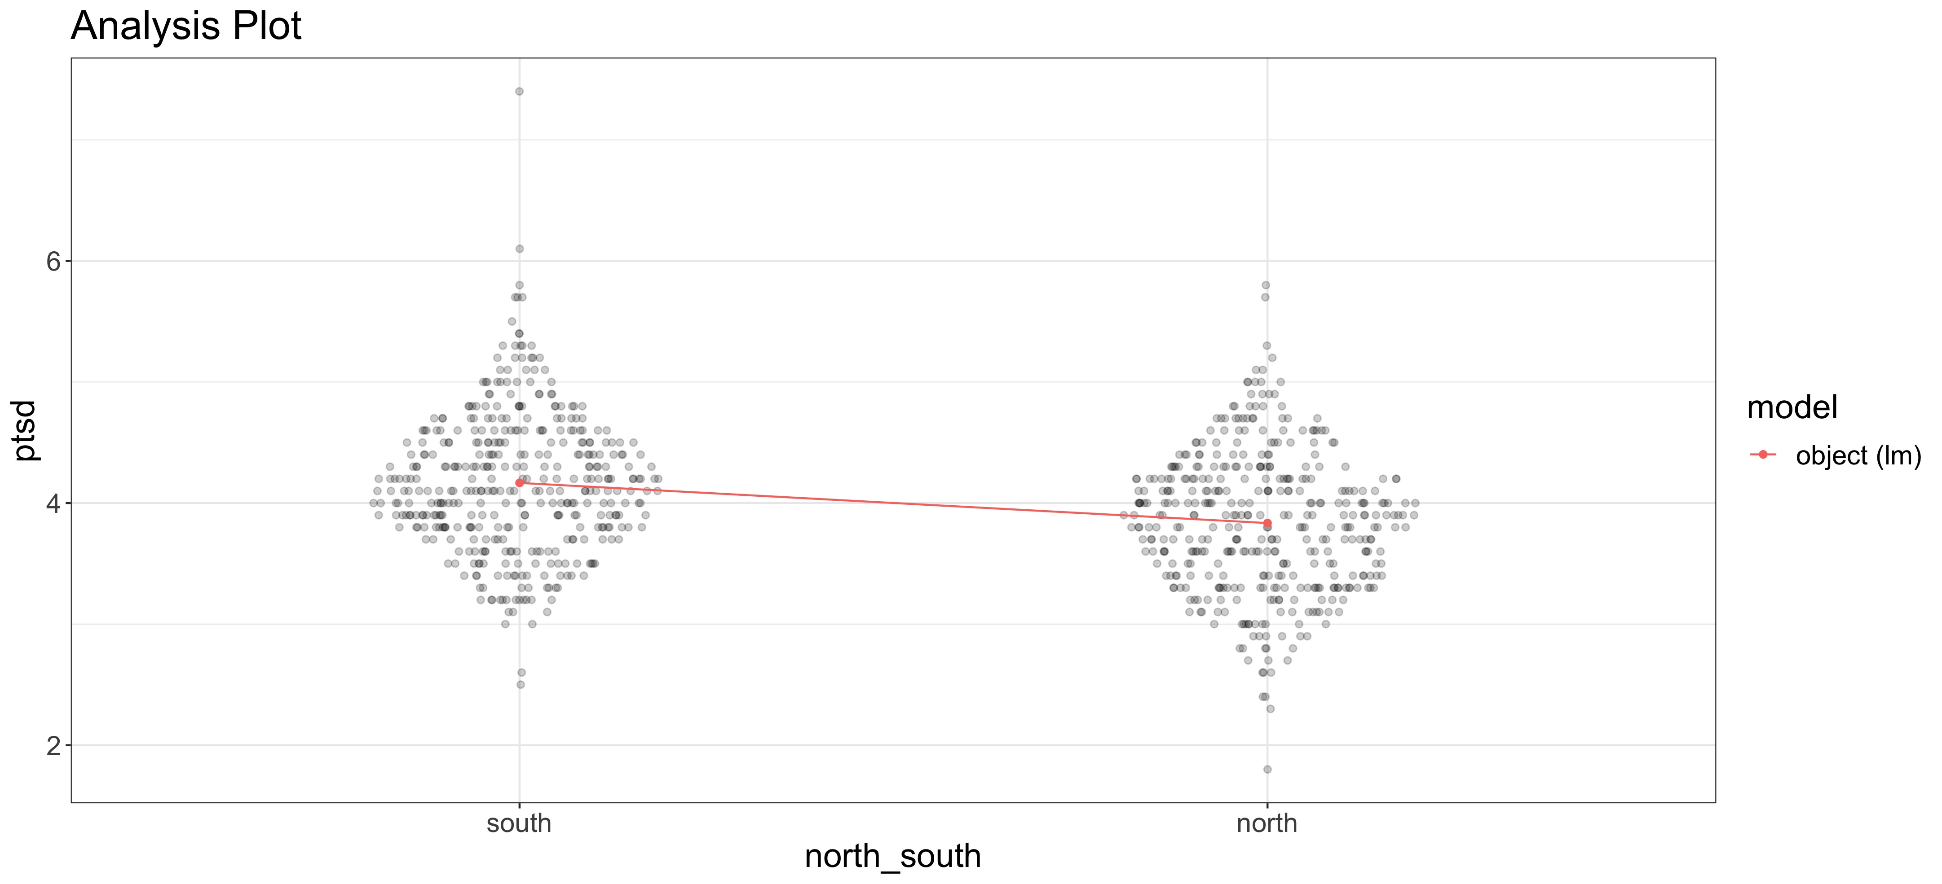
T-Test

Slide 6
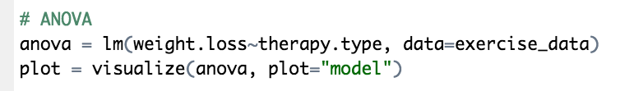
ANOVA

Slide 7
Regression

Slide 8
Mixed Models

Slide 9
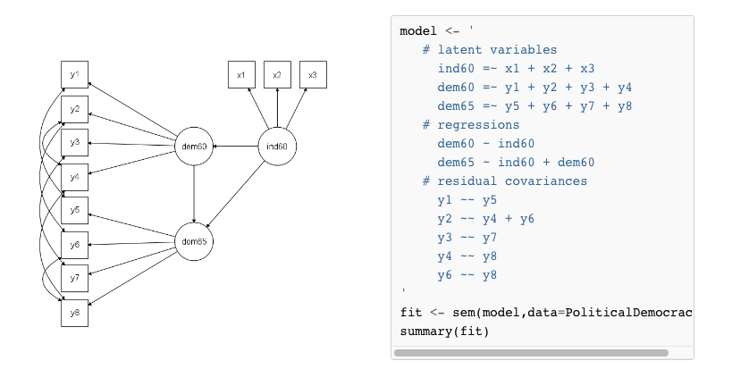
What is lavaan?
Latent Variable Analysis
Use observed variable
To hypothesize latent variables
Software for structural equation models

Slide 10
So...
flexplot + lavaan = flexplavaan
OR
easy plots +latent variable models = flexplavaan

Slide 11
So...
flexplot + lavaan = flexplavaan
OR
easy plots +latent variable models = flexplavaan
Flexplavaan is a software package for visualizing LVMs

Slide 12
But, there’s a problem!

Slide 13
Visualizing Latent Variable Models
They’re invisible!
Raw data??
Covariances

Slide 14
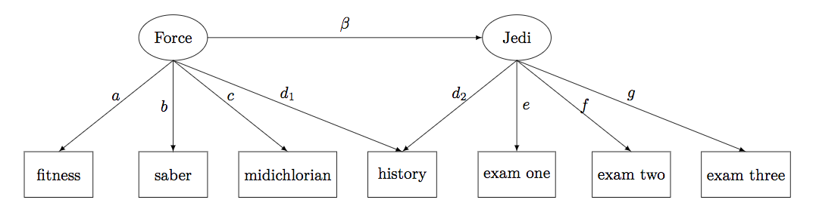
Jedi Example

Slide 15
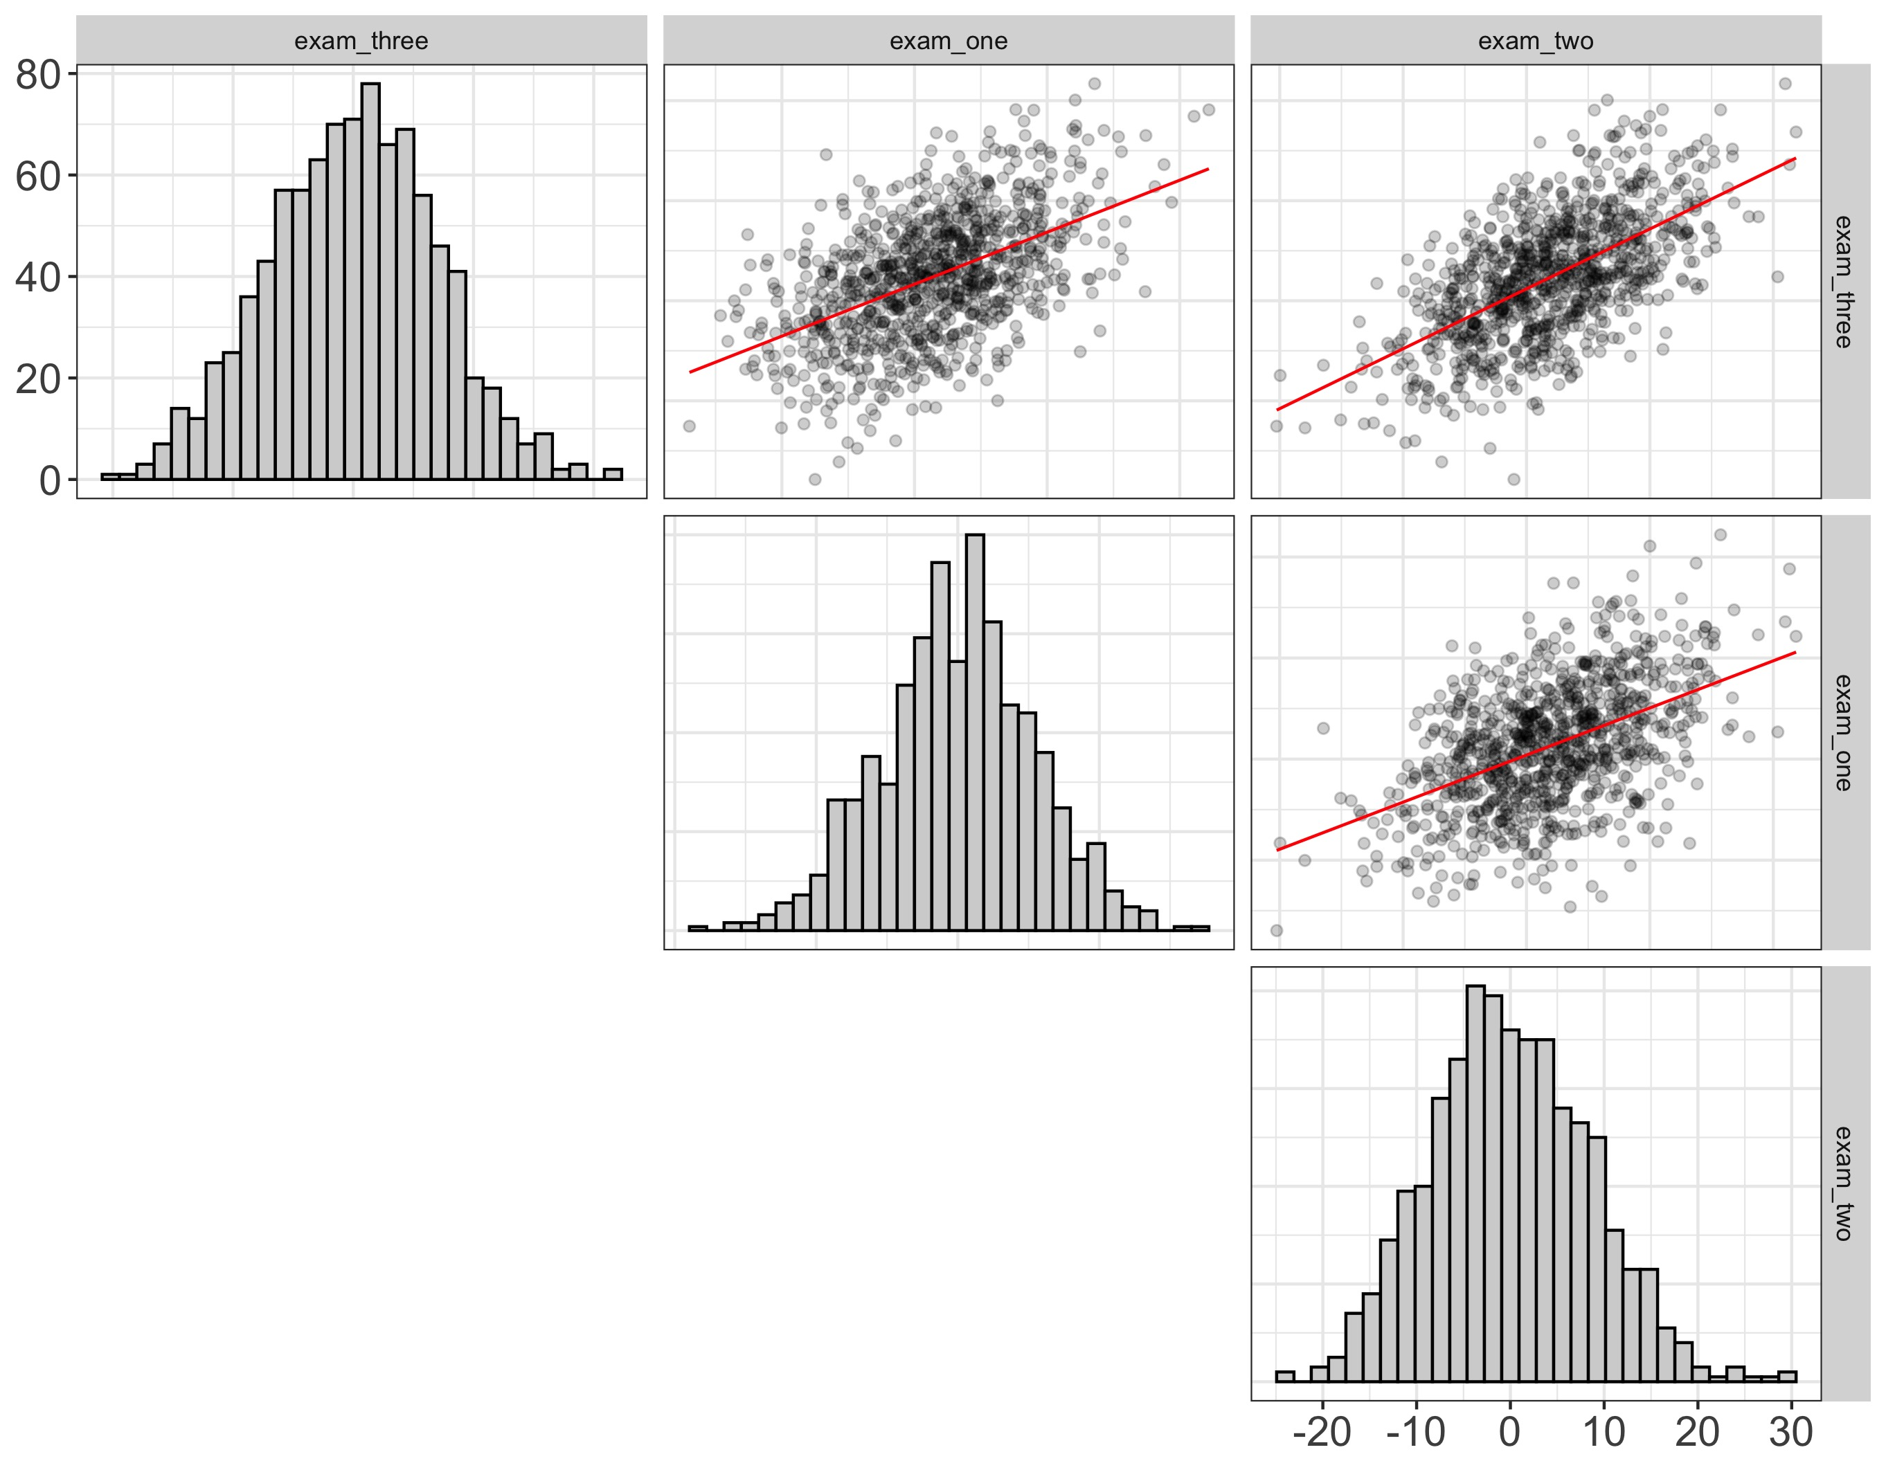
Basic idea
Scatterplot matrix of observed variables
Use implied covariance to estimate the “slope”

Slide 16
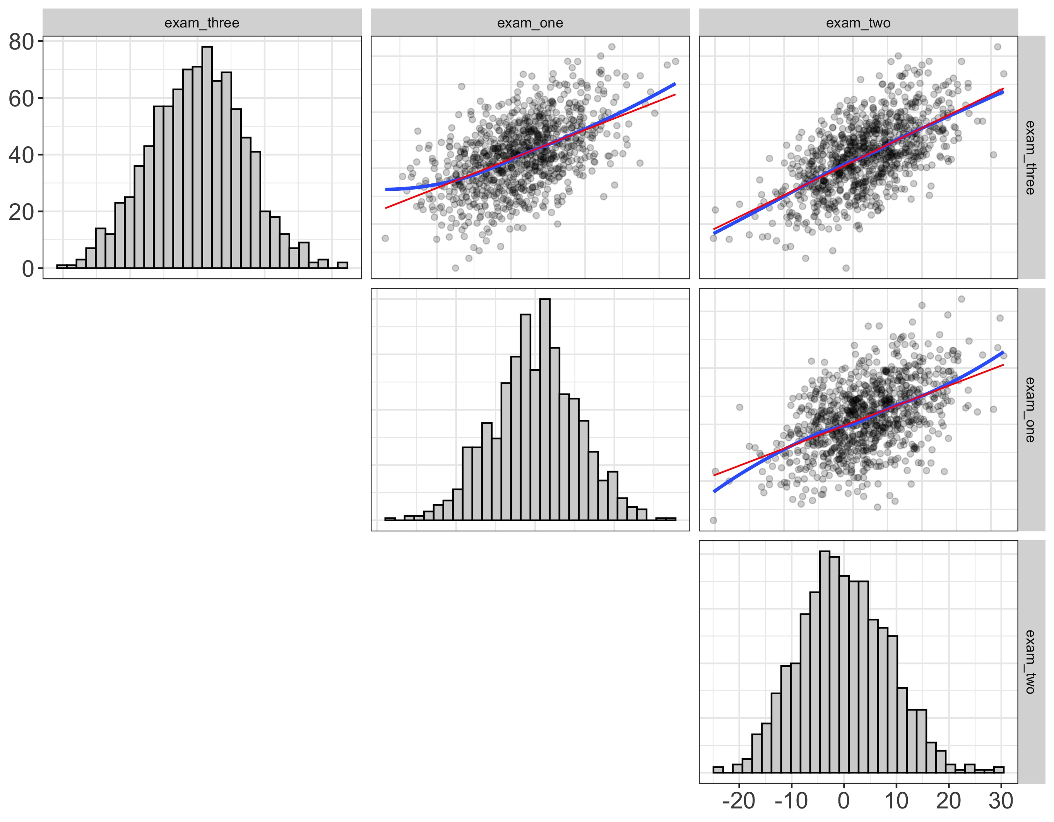
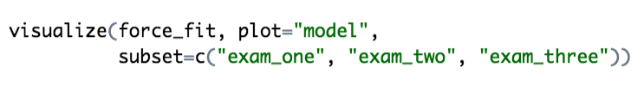
Basic idea
Scatterplot matrix of observed variables
Use implied covariance to estimate the “slope”
We can add “loess” lines

Slide 17
We can do better
Disturbance-Dependence Plots
Subtract effect of the model
If any “signal” remains, our model has problems

Slide 18
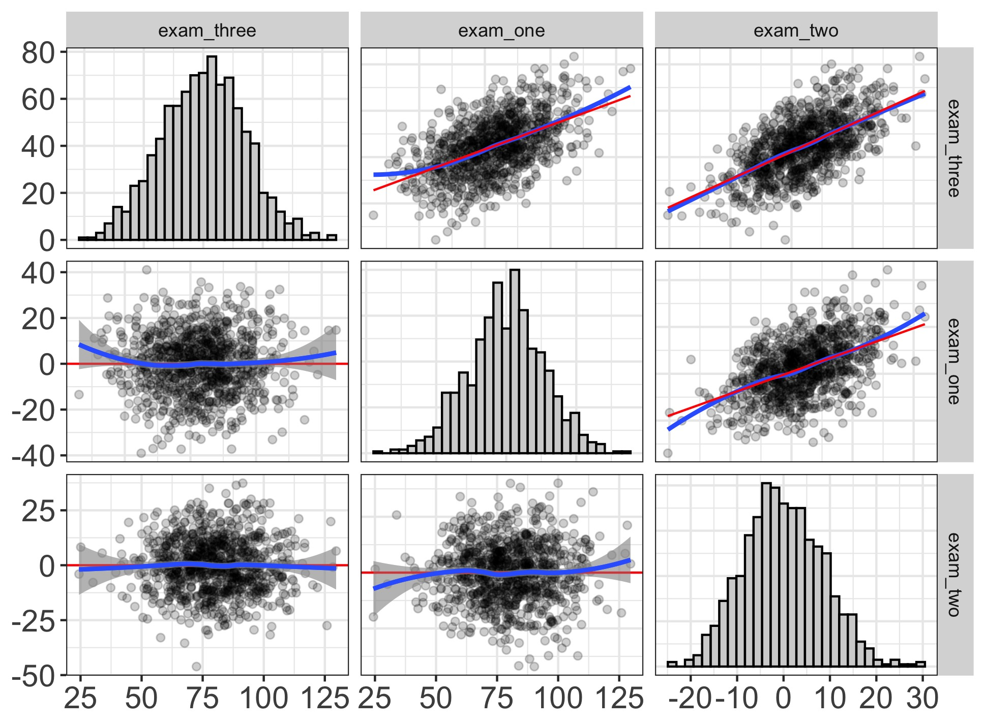
We can do better!
Disturbance-Dependence Plots
Subtract effect of the model
If any “signal” remains, our model has problems

Slide 19
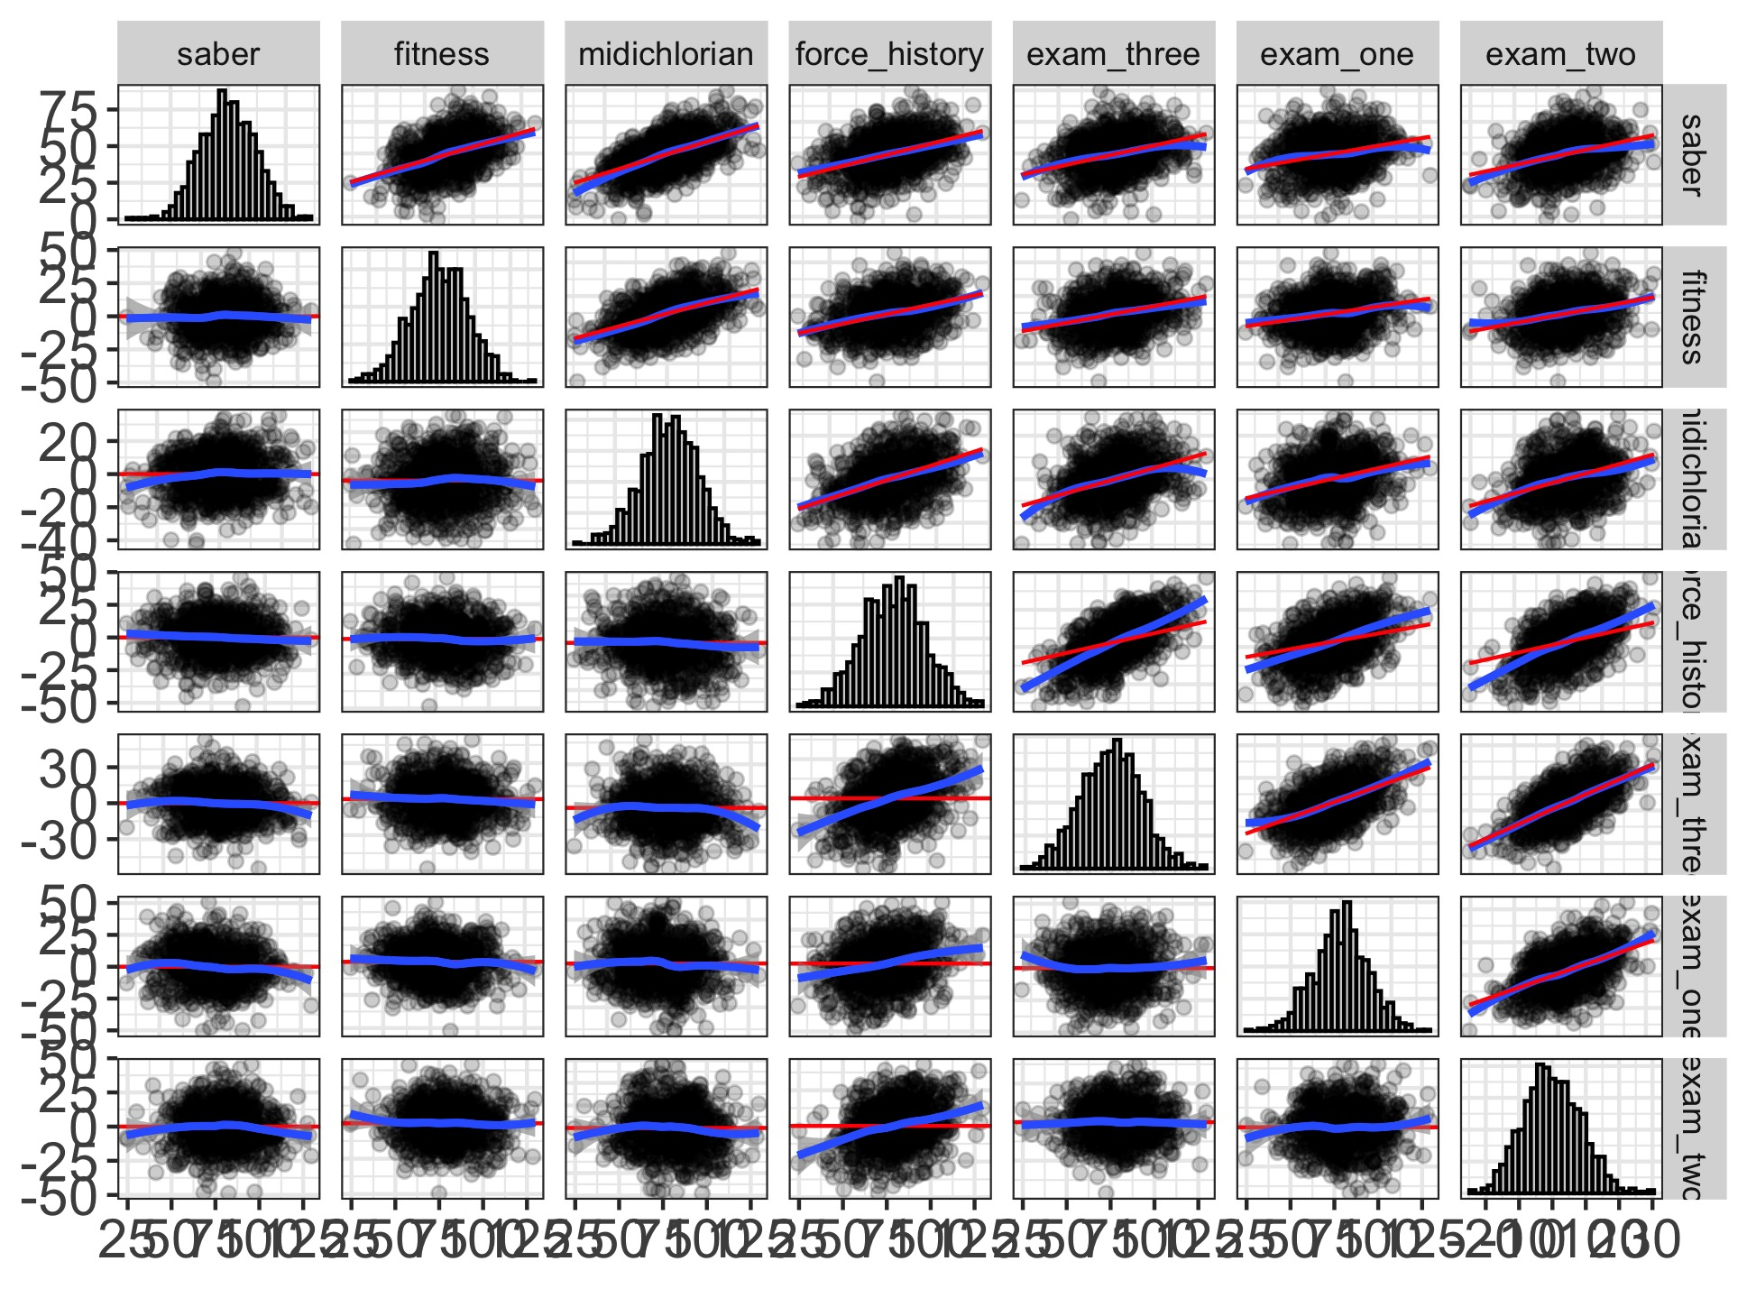

Or the whole model together...

Slide 20
We can also visualize the measurement model...

Slide 21
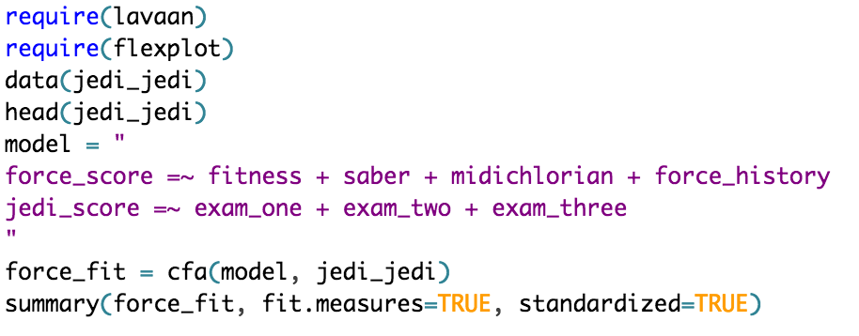
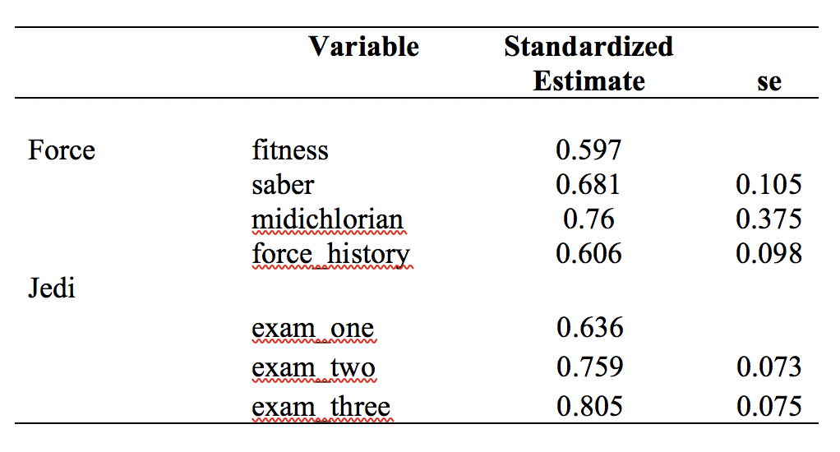
Fit
RMSEA = 0.165
cfi = 0.850
lti = 0.757

Slide 22
Problems…
These assume the model is correct
These assume linear relationships
because they’re based on covariances/means

Slide 23
Visualizing latent scores (Tay, not tay).
compute factor scores for every individual
study relationships between latent variables based on factor scores

Slide 24
Shadow Plots
Plot the items on the x/y axis
The line is the “fit”
or the relationship between x/y, implied by the model
the latent is lurking in the “shadows,” leaving its trace as a line
But how?

Slide 25
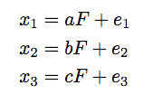
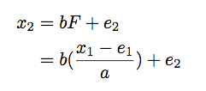
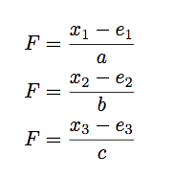
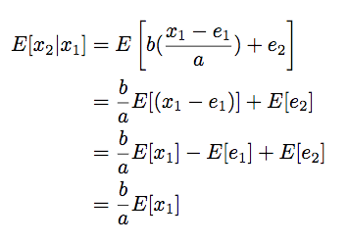
Scary Math
Model-implied equations for variables
Defining x2 in terms of x1
Re-expressed in terms of latent variable
Computing the conditional expectation

Slide 26
Easy as…

Slide 27
In an ideal world…

Slide 28
Not so fast!

Slide 29
Why
SEMs “correct” relationships for unreliability
The fitted line is what we would observe with perfect reliability
But we don’t have perfect reliability!

Slide 30
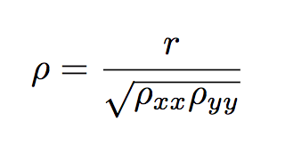
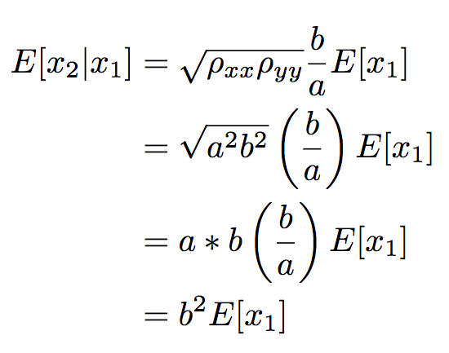
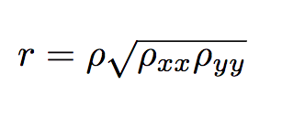
Danger!
Standard correction for unreliability
Plug it in to the previous equation
“Uncorrected” correlation

Slide 31
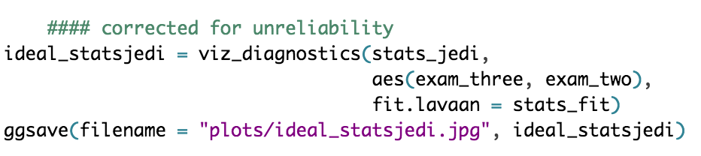
And now we get…

Slide 32
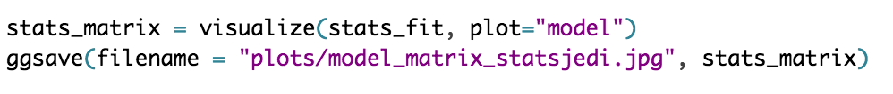
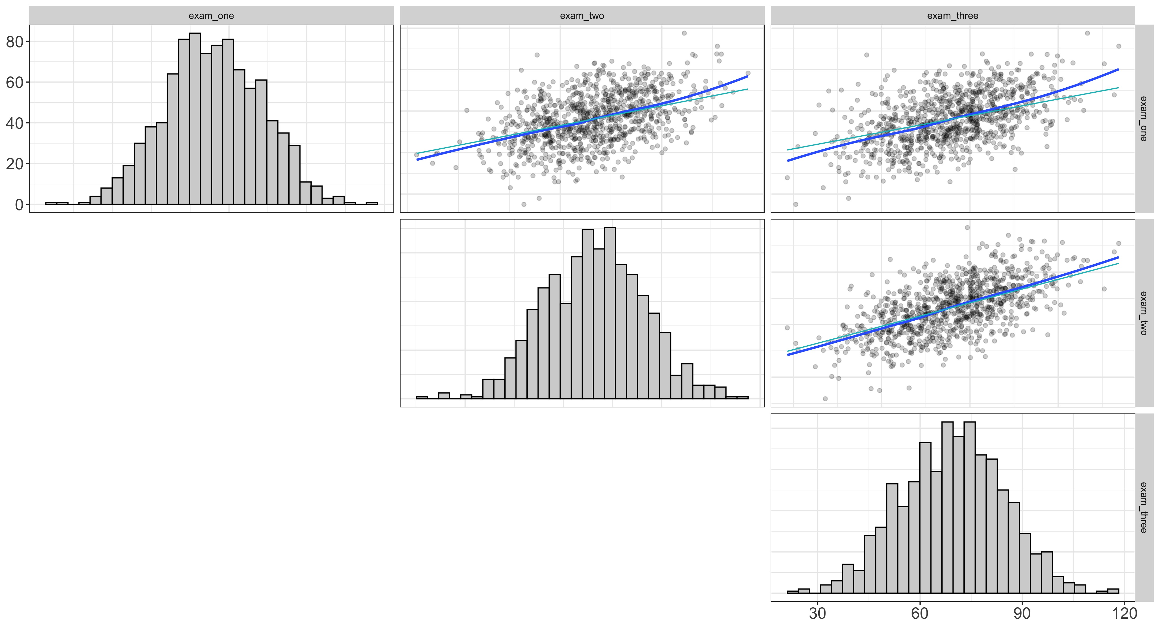
Or see them all…

Slide 33
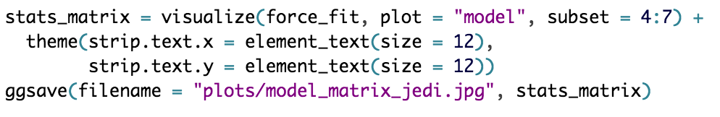
Or see them all…

Slide 34
Shadow plots
Advantages
good diagnostic tool
if the line ain’t going through the data, you know there’s misfit
highlights local misfit
easy to interpret
just standard regression
Disadvantages
may mask misfit
doesn’t improve encoding for the entire model
the math will fail if models are nonlinear

Slide 35
We can also do residual plots
Remember what a residual is
What remains of the DV after we’ve removed the (linear) effect of the IV
geometrically…

Slide 36
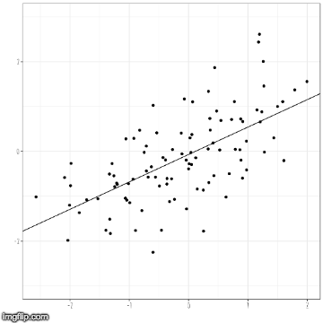
What is a residual?

Slide 37
Disturbance Dependence Plots
Shadow plots give us a “fit”
We can then subtract out the fit to get residuals
but we call them disturbances in SEM
we should have no relationship left
And for our data?

Slide 38
Stats

Slide 39
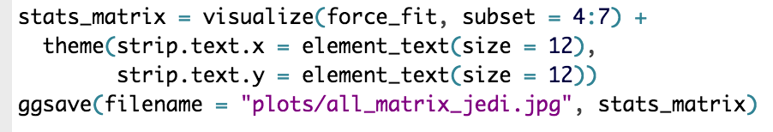
JEDI

Slide 40
Substantive Conclusions
Stats dataset fits quite well
all exams seem to be measuring the same thing
JEDI dataset has some problems
we’re consistently underestimating the relationship between force_history and the three Jedi exams
this suggests we should probably add a crossloading
boy, wouldn’t it be nice if we could visualize the fit of BOTH models??

Slide 41
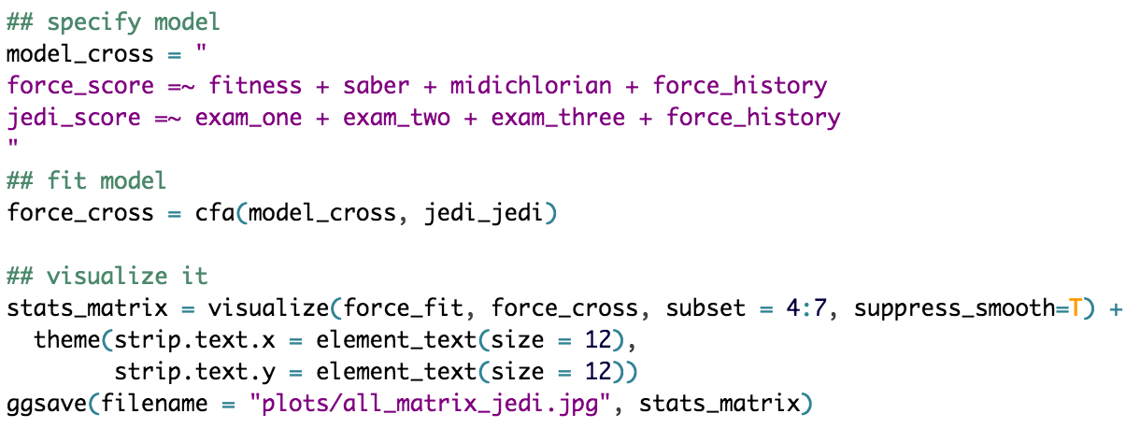
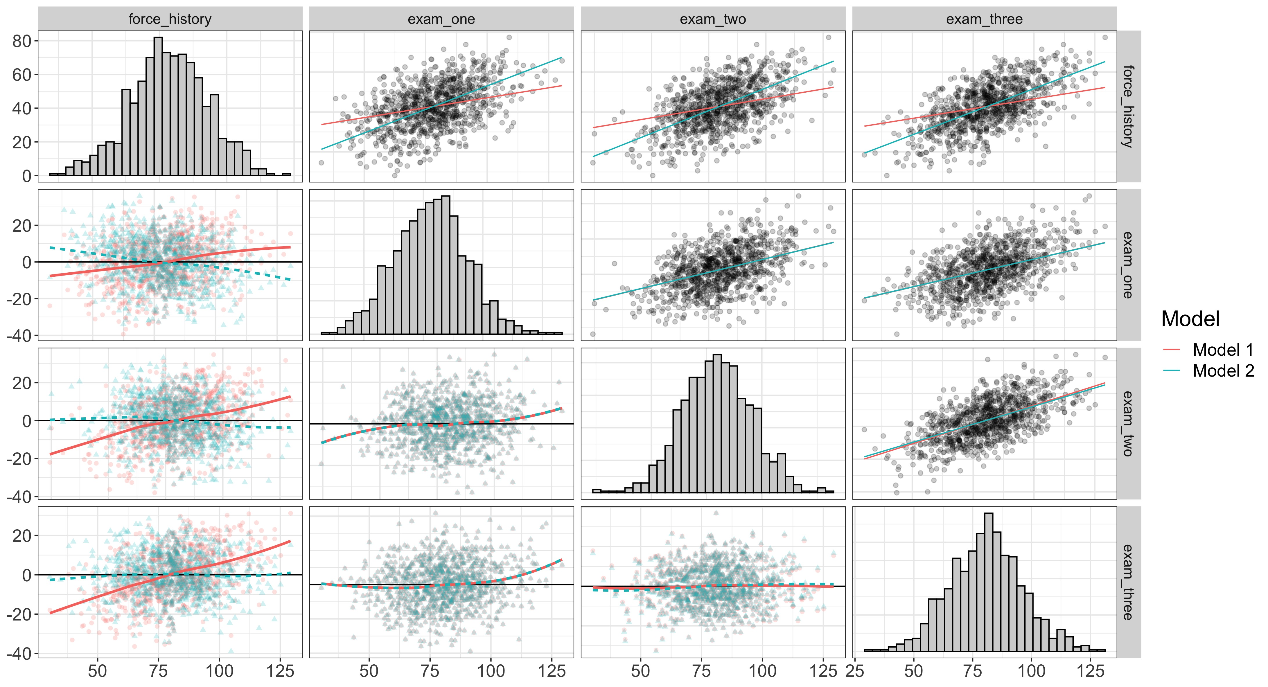
By golly, we can

Slide 42
Visualizing the measurement model
We have four variables
three observed
one latent
That’s a four dimensional plot
But let’s transform the data to long format
but first we transform the scale

Slide 43
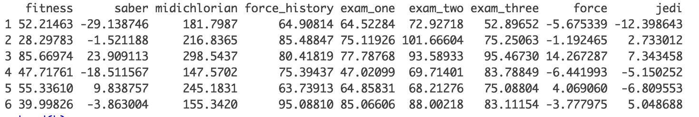
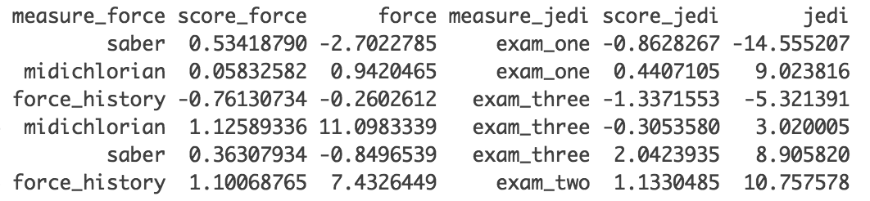
Wide to Long Format

Slide 44
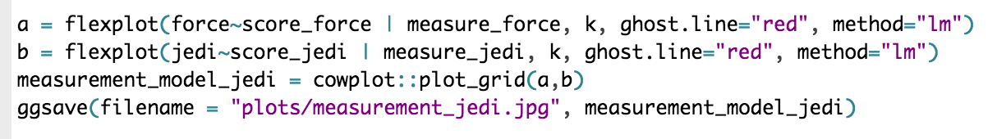
Flexplot

Slide 45
Nonlinear Models
These plots work great if the relationships are linear
But what if they’re not?

Slide 46
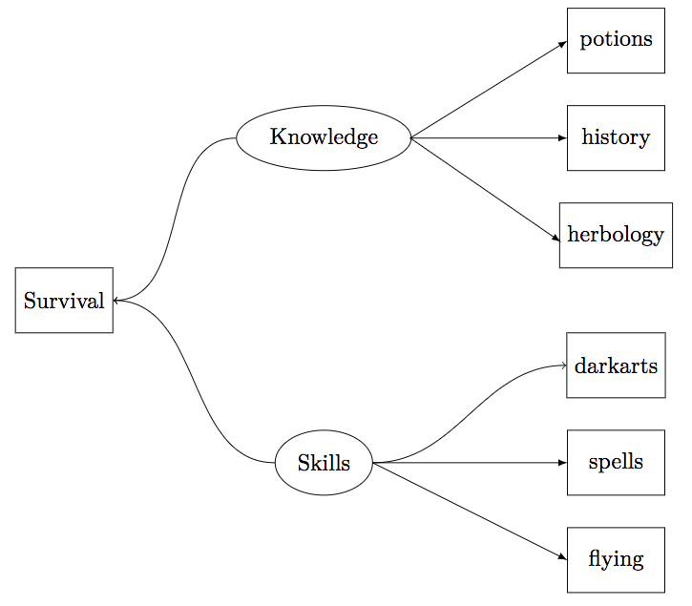
Example data
Hogwarts survival dataset
Nonlinear relationships between:
knowledge and survival
skills and survival
skills and darkarts

Slide 47
Problem
SEMs assume linear models
Can do a categorical model, but they suck
Wouldn’t it be nice if you could explicitly state each path?

Slide 48
Bayesian SEM
Much more flexible than regular SEM
Works with raw data
Able to estimate models regular SEM cannot
Naturally computes latent variables
But…

Slide 49
As of now…
There’s no general solution for visualizing these models
The implied model will depend on how the variables are related
So, I have to do more math ☹

Slide 50
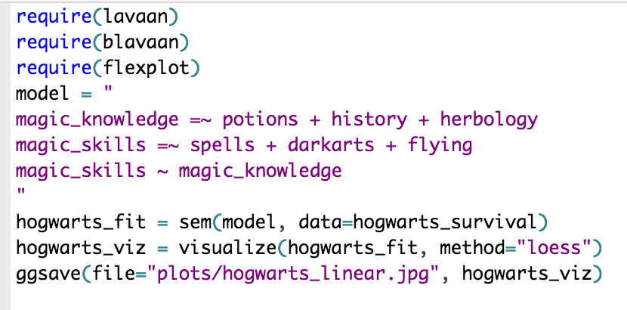
Naïve analysis

Slide 51
Naïve analysis

Slide 52
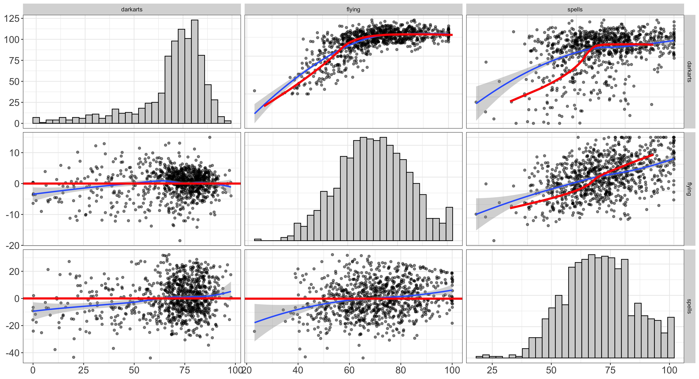
Let’s fit a Bayesian Model

Slide 53
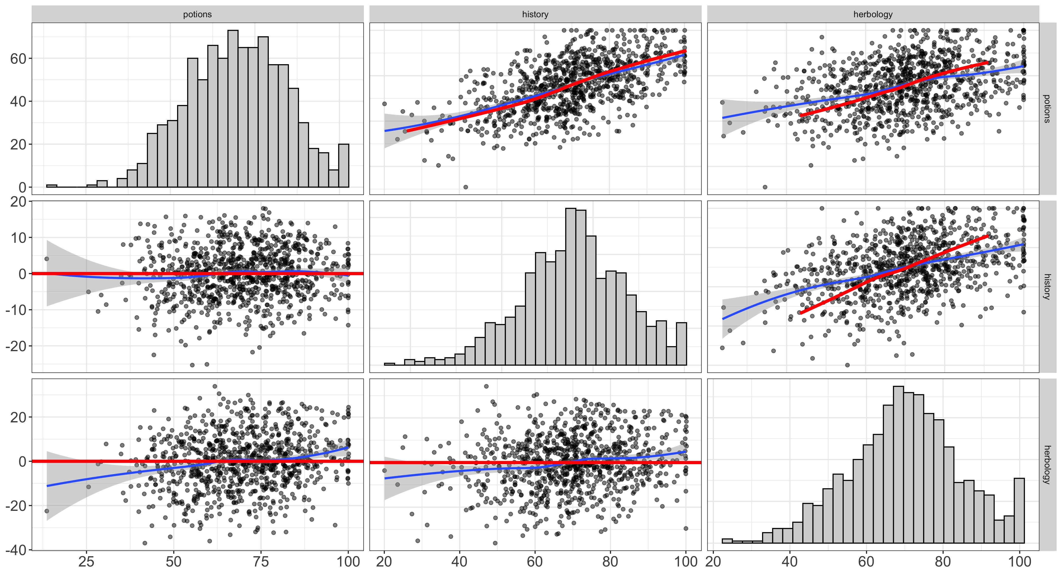

Slide 54
While that’s running…
Let’s review the math here.

